Slide 1
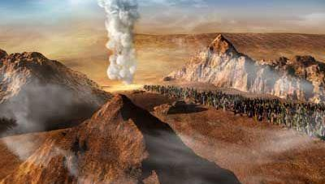

The Cloud’s Command of a 3 Yowmim Journey
Numbers 10
Joe Brown’s Lazy Dog jumpesNew Bunny Trail on Lunar
Joe Brown’s Lazy Dog jumpesNew Bunny Trail on Lunar
Joe Brown’s Lazy Dog jumpesNew Bunny Trail on Lunar
Joe Brown’s Lazy Dog jumpesNew Bunny Trail on Lunar

Slide 2
Will the Cloud’s provide eternal implications upon our lives for observing - THE WAY?
action

Slide 3

Searching the Scriptures According to Yahusha’s Torah
Will the Torah support the teaching of
man’s Lunar-Sabbath Calendar?

Slide 4
Num 10:11 And it came to be on the twentieth day of the second month, in the second year, that THE CLOUD was taken up from above the Dwelling Place of the Witness.
Exo 13:21 And יהוה went before them by day in a column of CLOUD to lead the way, and by night in a column of FIRE to give them light, so as to go by day and night.
Exo 13:22 The column of CLOUD did not cease by day, nor the column of FIRE by night, before the people.
Significance of – The Cloud

Slide 5
Exo 40:34 And the cloud covered the Tent of Meeting, and the esteem of יהוה [Yahuah] filled the Dwelling Place.
Exo 40:35 And Mosheh was not able to come into the Tent of Meeting, because the cloud dwelt on it, and the esteem of
יהוה [Yahuah] filled the Dwelling Place.
Exo 40:36 And when the cloud was taken up from above the Dwelling Place, the children of Yisra’ĕl went onward in all their journeys.
Exo 40:37 But if the cloud was not taken up, then they did not set out till the day that it was taken up.
Exo 40:38 For the cloud of יהוה [Yahuah] was on the Dwelling Place by day, and fire was on it by night, before the eyes of all the house of Yisra’ĕl, in all their journeys.

Slide 6
The Cloud - in - Numbers
Num 9:15 And on the day that the Dwelling Place was raised up,
the cloud covered the Dwelling Place, the Tent of the Witness. From evening until morning it was above the Dwelling Place
like the appearance of fire.
Num 9:16 Thus it was continually: the cloud covered it by day, and the appearance of fire by night.
Num 9:17 And whenever the cloud was taken up from above
the Tent, after that the children of Yisra’ĕl would depart.
And in the place where the cloud dwelt, there the children of Yisra’ĕl would camp.

Slide 7
Num 9:18 At the command of יהוה [Yahuah] the children of Yisra’ĕl departed, and at the command of יהוה [Yahuah] they camped. They remained camped as long as the cloud dwelt above the
Dwelling Place.
Num 9:19 Even when the cloud lingered many days above the Dwelling Place, the children of Yisra’ĕl guarded the Charge of יהוה [Yahuah], and did not depart.
Num 9:20 And so it was, when the cloud was above the Dwelling Place a few days: according to the command of יהוה [Yahuah] they camped, and according to the command of יהוה [Yahuah] they would depart.
Num 9:21 And so it was, when the cloud dwelt only from evening until morning: when the cloud was taken up in the morning, then they departed. Whether by day or by night, whenever the cloud was taken up, they departed.

Slide 8
Num 9:22 Whether two days, or a month, or a year that the cloud lingered above the Dwelling Place to dwell upon it, the children of Yisra’ĕl camped, and did not depart. But when it was taken up, they departed.
Num 9:23 At the command of יהוה [Yahuah] they camped, and at the command of יהוה [Yahuah] they departed. They guarded the Charge of יהוה [Yahuah], at the command of יהוה [Yahuah] by the hand of Mosheh.
Can we discern from whom Yisra’el’s authority to journey derived from?

Slide 9
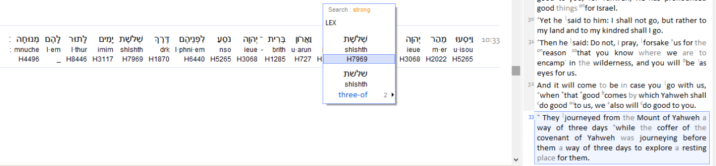
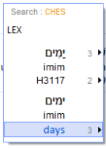
Yisra’el’s Three Yowm Journey
Num 10:33 So they set out from the mountain of יהוה [Yahuah] on a journey of three days. And the ark of the covenant of
יהוה went before them for the three days’ journey, to seek out a resting place for them.

Slide 10
Yisra’el’s Three Yowm Journey
Num 10:11 And it came to be on the TWENTIETH DAY of the second month, in the second year, that
THE CLOUD was taken up from above the Dwelling Place of the Witness.
Num 10:12 And the children of Yisra’ĕl departed, setting out from the Wilderness of Sinai. And the cloud dwelt on it in the Wilderness of Paran.
Num 10:13 Thus they departed the first time, according to the command of יהוה [Yahuah] by the hand of Mosheh.

Slide 11
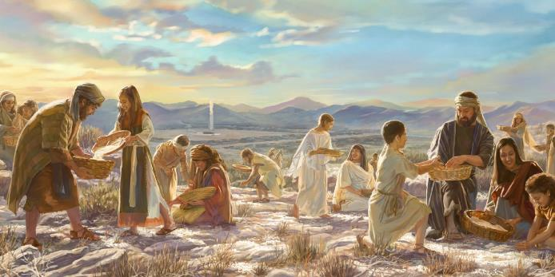
An important
consideration
before pressing forward with the 3 cycles
of travel!
Recall that Yahuah had tested the Hebrew nation, and proven through the manna week - the seventh day Sabbath. The 7th day Sabbath was a 24 hour cycle of NO SERVILE WORK. Note also that after the crossing of the Red Sea, they RESTED on the 7th day Sabbath.

Slide 12
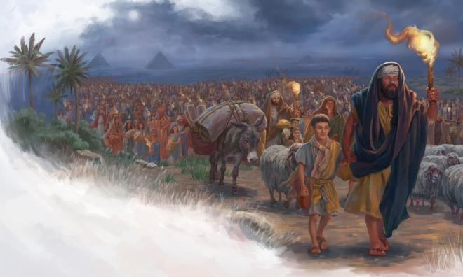
Question #1 Will Yahuah lead out the nation to travel during a 7th day Sabbath?
Question #2 - Upon which cycles of the month are the lunar Sabbaths to occur?
Is it not professed that their Sabbaths are on the 8th, 15th, 22nd, and 29th of their lunar months?

Slide 13

Note: A Lunar based Sabbath requirement is that a 7th day Sabbath is on the 22nd of EVERY MONTH!
The lunar based month that claim Sabbaths on the
8th, 15th, 22nd, and 29th of the month is a LOCKED calendar. It does not fluctuate nor change.
With this in mind, let’s get back to Num 10:11.

Slide 14
Num 10:11 And it came to be on the TWENTIETH DAY of the second month, in the second year, that THE CLOUD
was taken up from above the Dwelling Place of the Witness.
Please note what cycle of the month it was when Yahuah commanded, by the cloud, that the Hebrew nation needed to relocate to a better resting point.
It was the TWENTIETH DAY of the month,
when Yahuah decided the Hebrew nation must travel.
Let’s look at it!

Slide 15
Num 10:11 And it came to be on the twentieth day of the second month, in the second year, that the cloud was taken up from above the Dwelling Place of the Witness.
Num 10:12 And the children of Yisra’ĕl departed, setting out from the Wilderness of Sinai. And the cloud dwelt on it in the Wilderness of Paran.
Num 10:13 Thus they departed the first time, according to the command of יהוה [Yahuah] by the hand of Mosheh.

Slide 16
Since this type of lunar Sabbath calendar is locked,
that means each month is duplicated exactly the same – and - it matters not what number the month is!
The Lunar based Sabbath - month.
Lunar based Sabbaths.
Lunar Preparation day.
14th | 15th | 16th | 17th | 18th | 19th | 20th | 21st | 22nd | 23rd

Slide 17
Num 10:11 And it came to be on the TWENTIETH DAY of the second month, in the second year, that THE CLOUD was taken up from above the Dwelling Place of the Witness.
14th | 15th | 16th | 17th | 18th | 19th | 20th | 21st | 22nd | 23rd
1
2
3
Num 10:33 So they set out from the mountain of יהוה [Yahuah] on a
journey of three days. And the ark of the covenant of
יהוה [Yahuah] went before them for the three days’ journey,
to seek out a resting place for them.

Slide 18
“Journey of Three Days”! Why did Yahuah cause the Yisra’elites to travel through a Preparation day
and on through a 7th day Sabbath?
Lunar based Sabbath.
14th | 15th | 16th | 17th | 18th | 19th | 20th | 21st | 22nd | 23rd
1
2
3
Why would Yahuah by-pass a Preparation cycle to set up camp, but instead continued to travel on a 7th day Sabbath?
What about Malachi 3:6 For I am Yahuah, I shall not change! …

Slide 19
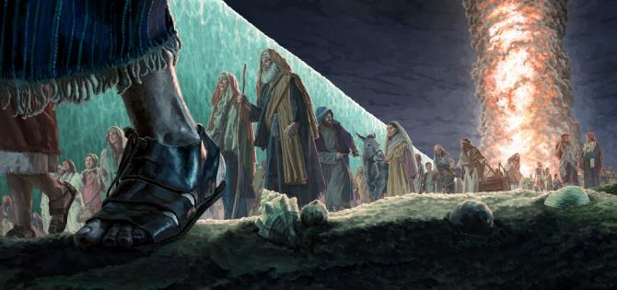
On the Manna Week test, (the year before),
the children of Yisra’el were taught by Yahuah,
to be PREPARED on the Preparation cycle, to facilitate a REST period
on the 7th day Sabbath.
Did not Yahuah have the children of Yisra’el PREPARED through the Red Sea Preparation night for salvation, (from the Mitsrites), so at Dawn they could REST on the 7th day Sabbath? We simply cannot forget –

Slide 20
Exo 20:8 “Remember the Sabbath day, to set it apart.
Exo 20:9 “Six days you labour, and shall do all your work,
Exo 20:10 but the seventh day is a Sabbath of יהוה [Yahuah] your Elohim. You do not do any work – you, nor your son, nor your daughter, nor your male servant, nor your female servant, nor
your cattle, nor your stranger who is within your gates.
Exo 20:11 “For in six days יהוה [Yahuah] made the heavens and the earth, the sea, and all that is in them, and rested the seventh day. Therefore יהוה [Yahuah] blessed
the Sabbath day and - set it apart.”

Slide 21
Why would Yahuah go against His Qodesh Pattern and cause
the Yisra’elites to travel
needlessly on a 7th day Sabbath?
Lunar based Sabbath.
14th | 15th | 16th | 17th | 18th | 19th | 20th | 21st | 22nd | 23rd
1
2
3
Why did Yahuah not take the opportunity to have
the Yisra’elites camp on the Preparation cycle
to facilitate a REST on the 7th day Sabbath?

Slide 22

Did Yahuah not realize
that to travel and set up camp on the third cycle of the journey was a LOT OF SERVILE WORK?
Lunar based Sabbath.
14th | 15th | 16th | 17th | 18th | 19th | 20th | 21st | 22nd | 23rd
1
2
3
Maybe this lunar month was an exception to the rules of the pagan system of worship?

Slide 23
Maybe the lunar system
of worship is
NOT SCRIPTURAL?
Lunar based Sabbath.
14th | 15th | 16th | 17th | 18th | 19th | 20th | 21st | 22nd | 23rd
1
2
3
Isa 1:14 “My being HATES your New Moons and
your appointed times, they are a trouble to Me,
I am weary of bearing them.

Slide 24
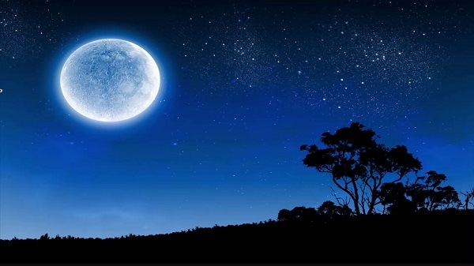
Isa 1:15 “And when you spread out your hands, I hide My eyes from you; even though you make many prayers, I do not hear. Your hands have become filled with blood.
16 “Wash yourselves, make yourselves clean; put away the evil of your doings from before My eyes. Stop doing evil!

Slide 25

On the Blood Ratified Covenant Calendar,
what cycle of the week did the cloud of Yahuah lift?
14th | 15th | 16th | 17th | 18th | 19th | 20th | 21st | 22nd | 23rd
What could the eternal implications be depending upon which cycle of the week this 20th of the 2nd month was?

Slide 26
The “WHEN” of Yahuah’s Cloud
2nd Year (1st month - Wilderness)
 |  |  |  |  |  | 1st
2nd | 3rd | 4th | 5th | 6th | 7th | 8th
9th | 10th | 11th | 12th | 13th | 14th | 15th
16th | 17th | 18th | 19th | 20th | 21st | 22nd
23rd | 24th | 25th | 26th | 27th | 28th | 29th
30th
Tabernacle raised here.
Exo 40:2, 17
2nd
Month
 | 1st | 2nd | 3rd | 4th | 5th | 6th
7th | 8th | 9th | 10th | 11th | 12th | 13th
14th | 15th | 16th | 17th | 18th | 19th | 20th
21st | 22nd | 23rd | 24th | 25th | 26th | 27th
28th | 29th | 30th
Num 10:11
Yahuah LIFTED THE CLOUD ON THIS SHABBAT!

Slide 27
Yahuah’s Cloud Commands a - 3 Cycle Journey
2nd Year (2nd month - Wilderness)
Num 10:11 And it came to be on the twentieth day of the second month, in the second year, that the cloud was taken up from above the Dwelling Place of the Witness.
 | 1st | 2nd | 3rd | 4th | 5th | 6th
7th | 8th | 9th | 10th | 11th | 12th | 13th
14th | 15th | 16th | 17th | 18th | 19th | 20th
21st | 22nd | 23rd | 24th | 25th | 26th | 27th
28th | 29th | 30th
Num 10:33 So they set out from the mountain of יהוה [Yahuah] on a journey of three days. And the ark of the covenant of יהוה went before them for the three days’ journey, to seek out a resting place for them.

Slide 28
Yahuah’s Cloud - The Sign!
2nd Year (2nd month - Wilderness)
The Cloud was lifted signaling
their 1st journey!
Num 10:11
 | 1st | 2nd | 3rd | 4th | 5th | 6th
7th | 8th | 9th | 10th | 11th | 12th | 13th
14th | 15th | 16th | 17th | 18th | 19th | 20th
21st | 22nd | 23rd | 24th | 25th | 26th | 27th
28th | 29th | 30th
The 20th was a
7th day Shabbat!
The next Dawn begins the new week!
The next Dawn, it was time to travel!

Slide 29
Reviewing - Man’s Lunar Sabbath?
2nd Year (2nd month - Wilderness)
Did Yahuah cause His people to journey on the LUNAR Sabbath? What about the Manna week theology of no servile work on the Shabbat? Does it become null and void now? “ANOTHER EXCEPTION”?
 | 1st | 2nd | 3rd | 4th | 5th | 6th
7th | 8th | 9th | 10th | 11th | 12th | 13th
14th | 15th | 16th | 17th | 18th | 19th | 20th
21st | 22nd | 23rd | 24th | 25th | 26th | 27th
28th | 29th | 30th
The intent was to find a resting place. Did the “rest” come in the midst of the 3 cycle journey? Does the word – journey – have the same meaning as – rest (SHABBAT)?
Was it actually only a 2 cycle journey with a rest in between?

Slide 30
Review ~ A Shabbat Rest, or a Rest Location?
No! The Hebrew word translated as – rest – in this verse is – H4496 Menuwchah – a resting PLACE! Not a rest as in a Shabbat! The people of the Hebrew nation were journeying on a normal week cycle, the 22nd of the 2nd month!
 | 1st | 2nd | 3rd | 4th | 5th | 6th
7th | 8th | 9th | 10th | 11th | 12th | 13th
14th | 15th | 16th | 17th | 18th | 19th | 20th
21st | 22nd | 23rd | 24th | 25th | 26th | 27th
28th | 29th | 30th
Interesting note: The Hebrew nation were not observing a 2nd Passover and Unleavened Bread Feast Shabbat.
They were traveling!

Slide 31


Did the Torah Give Clarity?
Let’s remember to keep our understanding for Yahusha’s Covenant Calendar grounded in the roots of Torah.
The End!

Slide 32


If you have Questions &/or Comments
about this teaching, please contact:
Timothy Astleford
tim@studythecalendar.com
Thank you!
32

